Slide 1


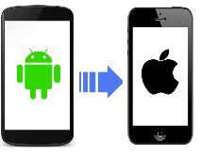
Framework Architecture
JENKINS
Continuous regression builds
Remote builds Execution
Maven Project with Java, Selenium, Appium
SVN / GitHub
ECLIPSE / INTELLIJ
Test Data
Config Files
CONFIGURATION
# EXECUTION ENV
# CREDENTIALS
TestNG Class
Business Flows
Functions
Page Object Library
# UI OBJECTS
# BUSINESS FUNCTIONS
BASE LIBRARIES
# COMMON LIBRARY
# EXCEPTION HANDLING
# API AND DB CONNECTIONS
Base Libraries
TestNG
Report
Allure
Report
Custom Reports
# HTML REPORTS
Test Execution
Test Execution

